Slide 1
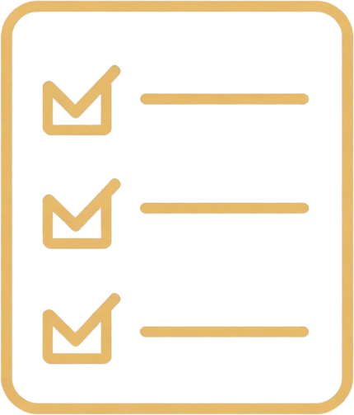

•••
MERN-Based Study Planner
Smart Study Schedules with Progress Tracking
Presented by [KUSUMA
AKASHYA
KEERTHANA
MAHESH]
•••

Slide 2

•••
PROBLEM STATEMENT
Poor Time Management
Students struggle to allocate study time effectively across multiple subjects, leading to last-minute cramming and burnout before exams.
Missed Deadlines & No Progress Tracking
Without a centralized planner, students miss assignment deadlines and have no visibility into their study completion or progress over time.
•••
02

Slide 3
•••
PROJECT GOALS
Unified Study Planner: Build one intelligent platform that automatically organizes studying — eliminating manual scheduling and keeping students on track with deadlines and tasks.
Smart Schedule Generation: Automatically generate personalized study schedules based on subjects, deadlines, and availability — then monitor task completion in real time.
•••
03

Slide 4


•••
MERN ARCHITECTURE
FRONTEND — React.js
• Dynamic UI for schedule views
• Task creation & management
• Progress dashboards & charts
• Real-time completion tracking
• Responsive, mobile-friendly design
• Axios for REST API calls
• React Router for navigation
• Context API for state management
BACKEND — Node.js & Express
• RESTful API endpoints
• User authentication (JWT)
• Schedule generation logic
• MongoDB via Mongoose ODM
• Collections: Users, Tasks, Schedules
• CRUD operations for all entities
• Middleware for auth & validation
• Deployed via Render / Railway
•••
04

Slide 5

•••
HOW IT WORKS
📅 Enter subjects & deadlines
⏰ Set your available study hours
📋 Algorithm builds your plan
✅ Receive a day-by-day schedule
🔄 Auto-adjusts as you progress
•••
05

Slide 6
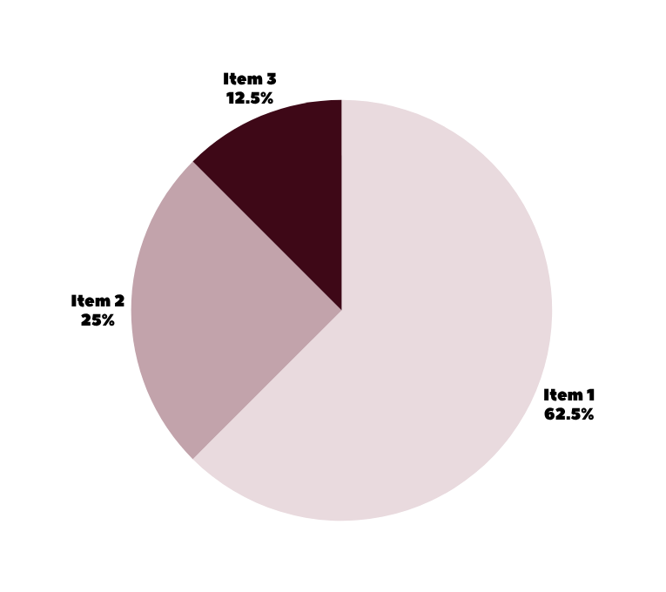
•••
PROGRESS ANALYTICS
Completion Tracking Dashboard
✔ Completed vs. remaining tasks visualized in real time
✔ Daily, weekly & monthly progress reports
✔ Automatic completion percentage per subject
✔ Missed deadlines flagged instantly
✔ Streak tracking to boost consistency
✔ MongoDB aggregation powers all metrics
•••
06

Slide 7
•••
CONCLUSION
• A single MERN app empowers students to plan, track, and succeed
• Automated schedules eliminate poor time management
• Progress monitoring ensures deadlines are never missed
• Clean, responsive UI keeps students engaged and on track
Next Steps: User testing → Refinement → Full Deployment
•••
07

Slide 8
THANK YOU

